Slide 1
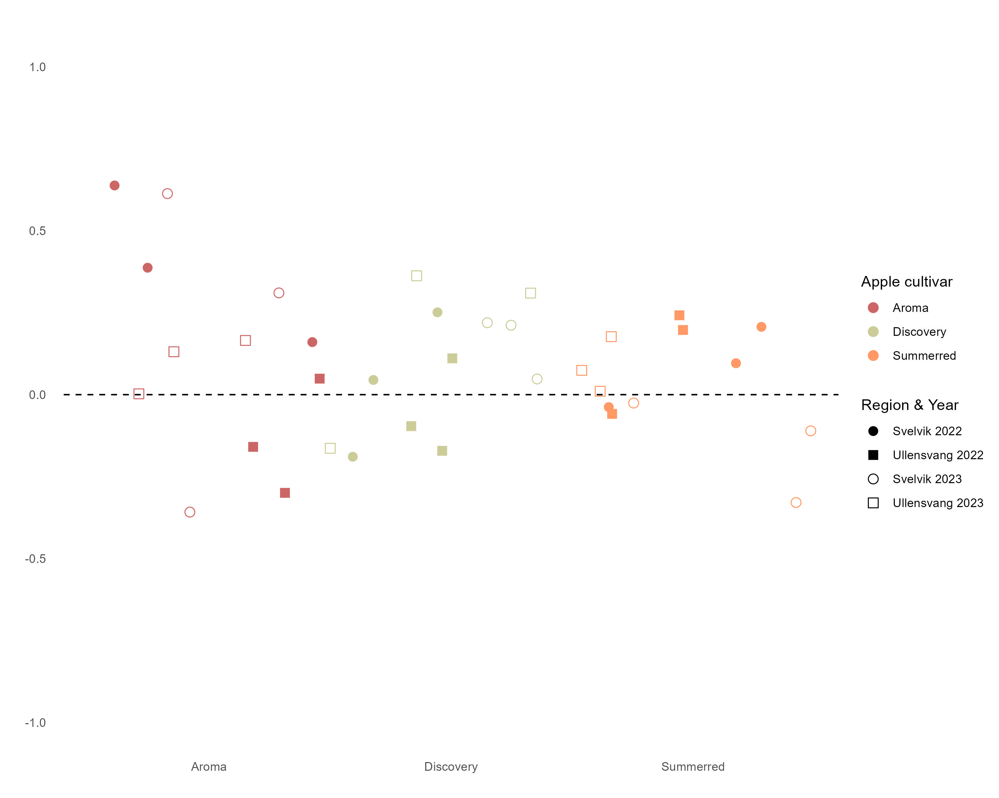
Deficit
Surplus

Slide 2
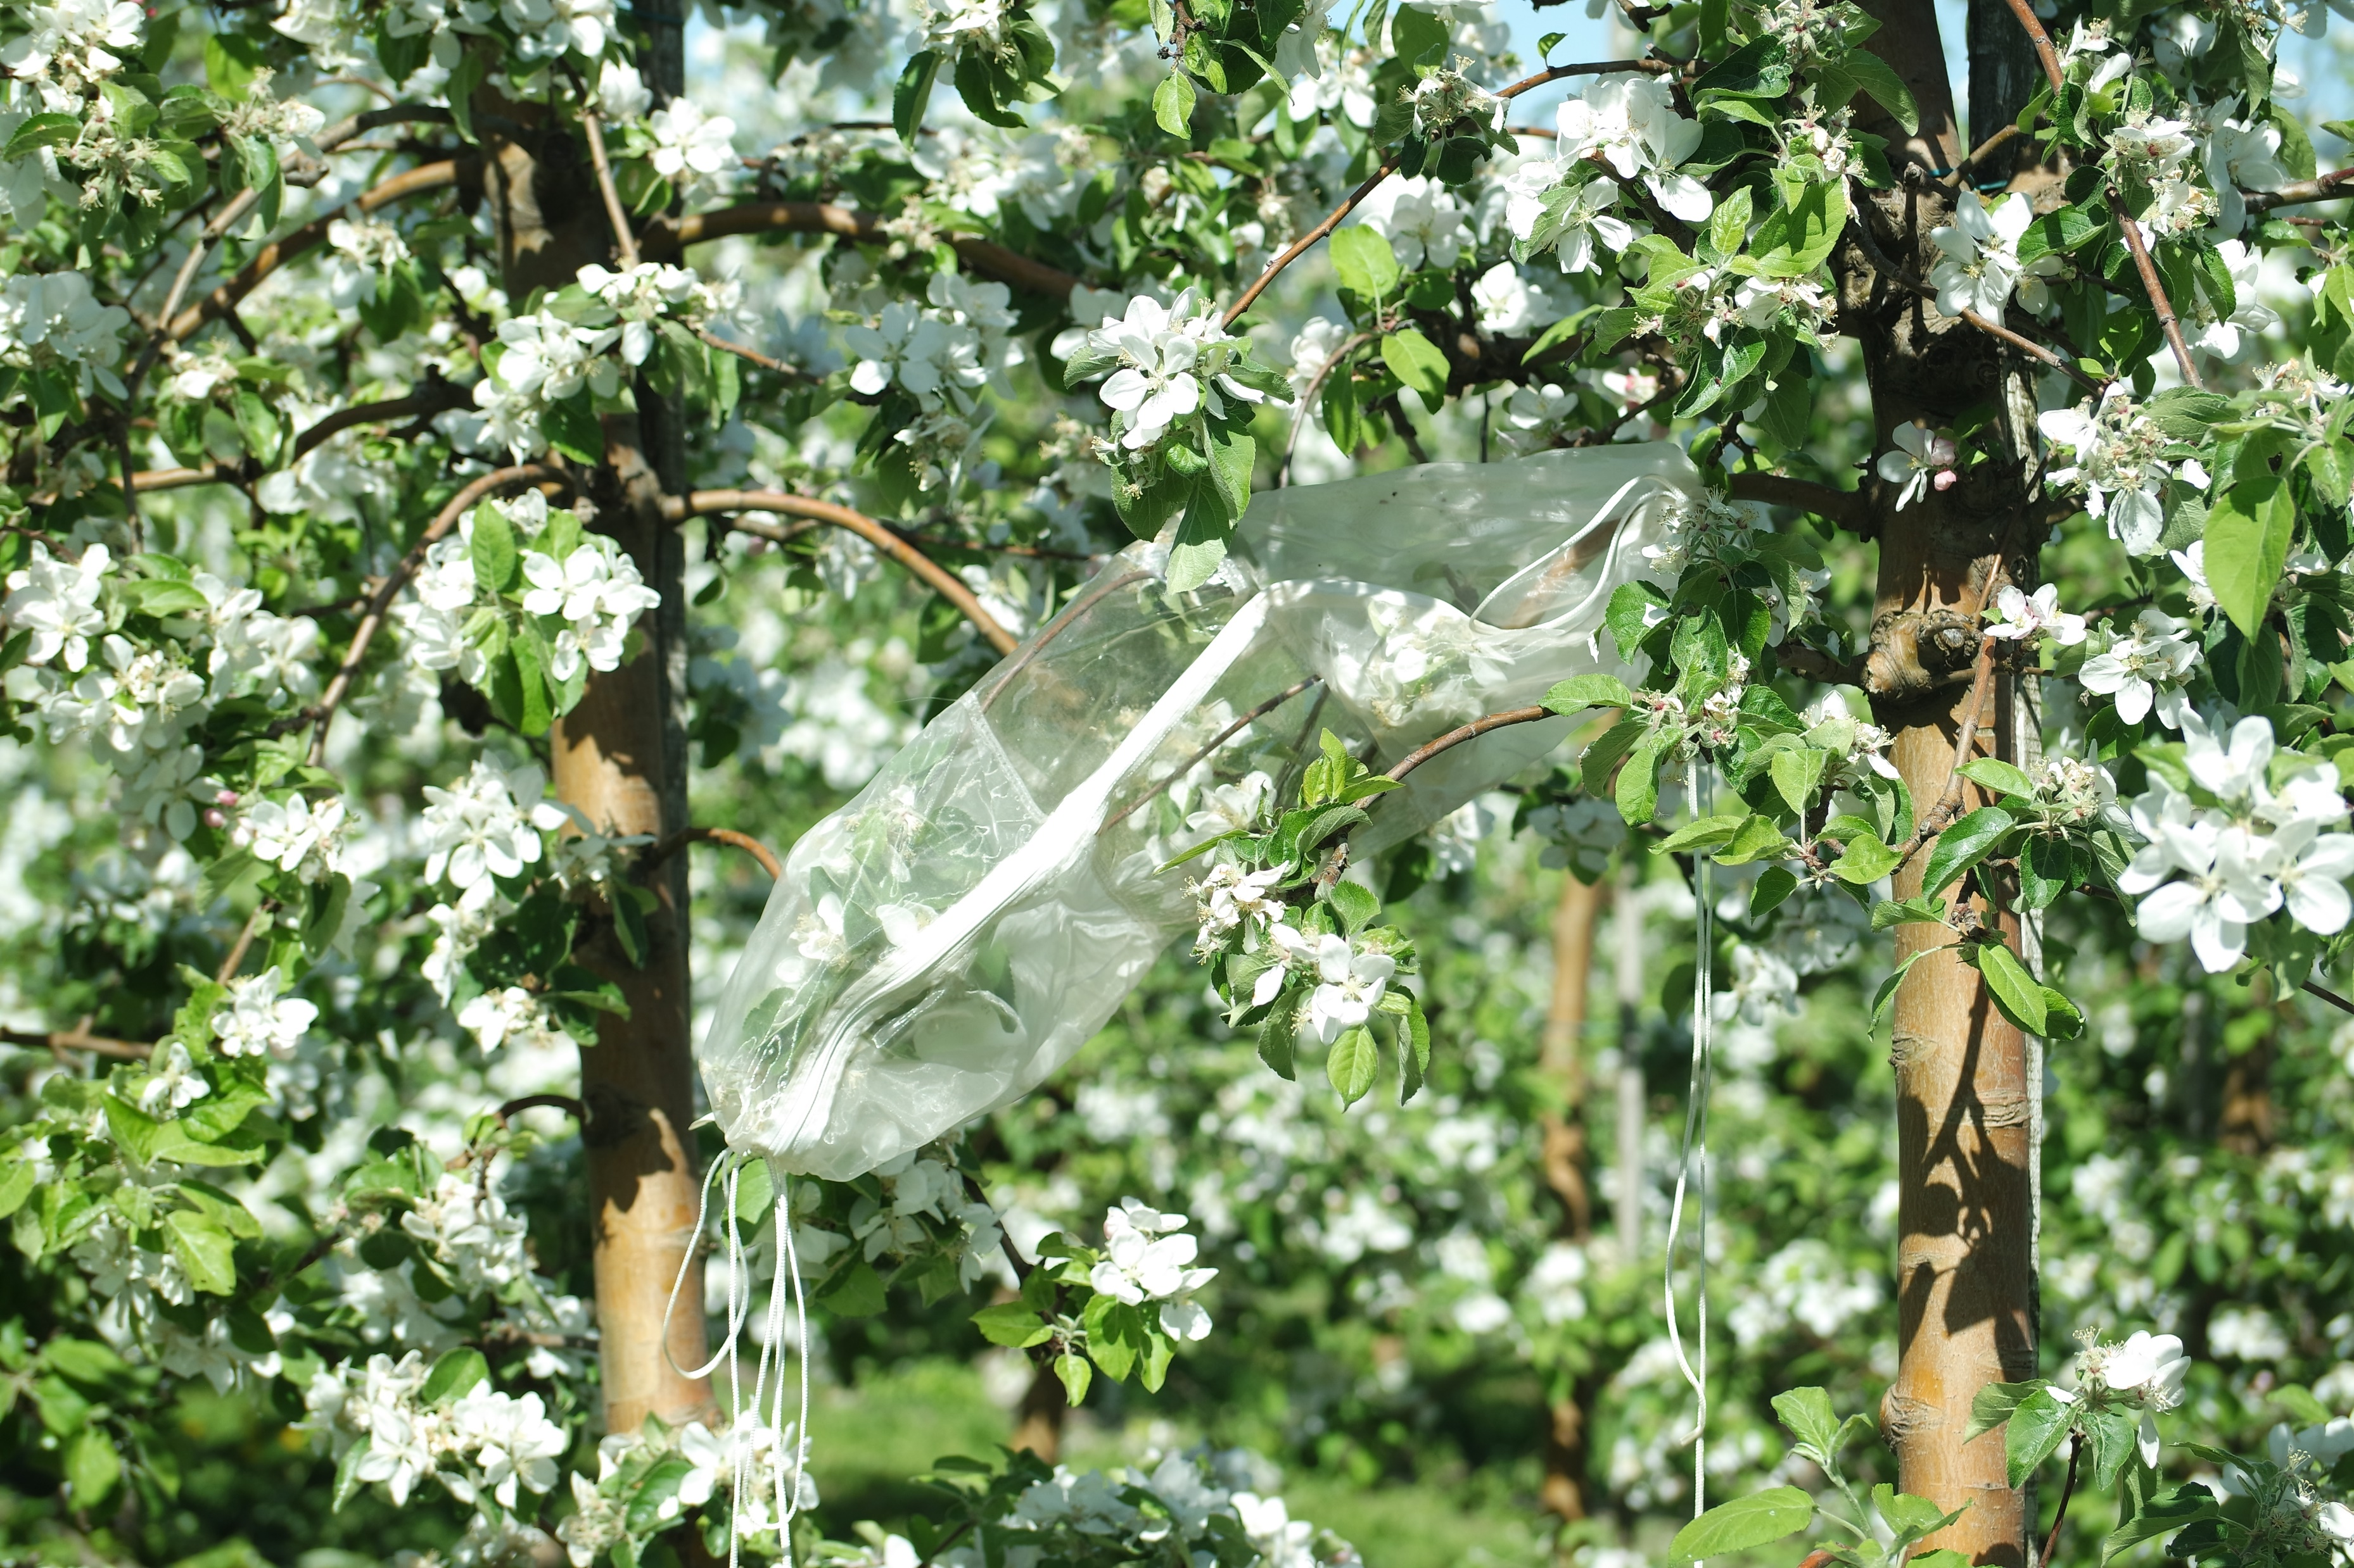
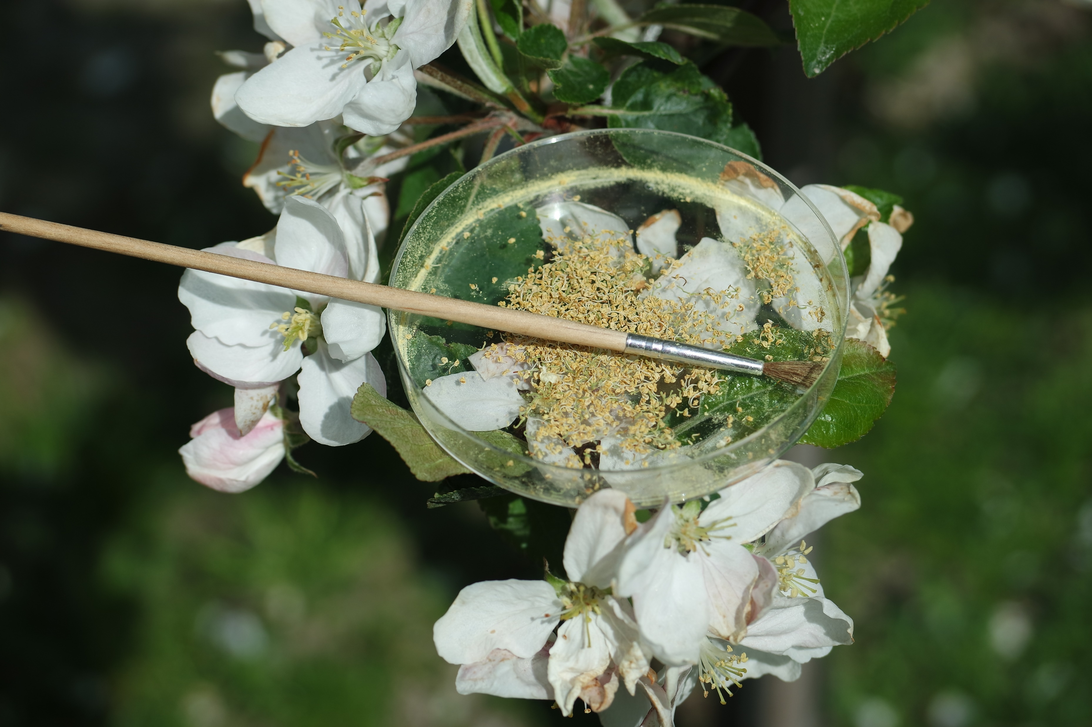

Slide 3
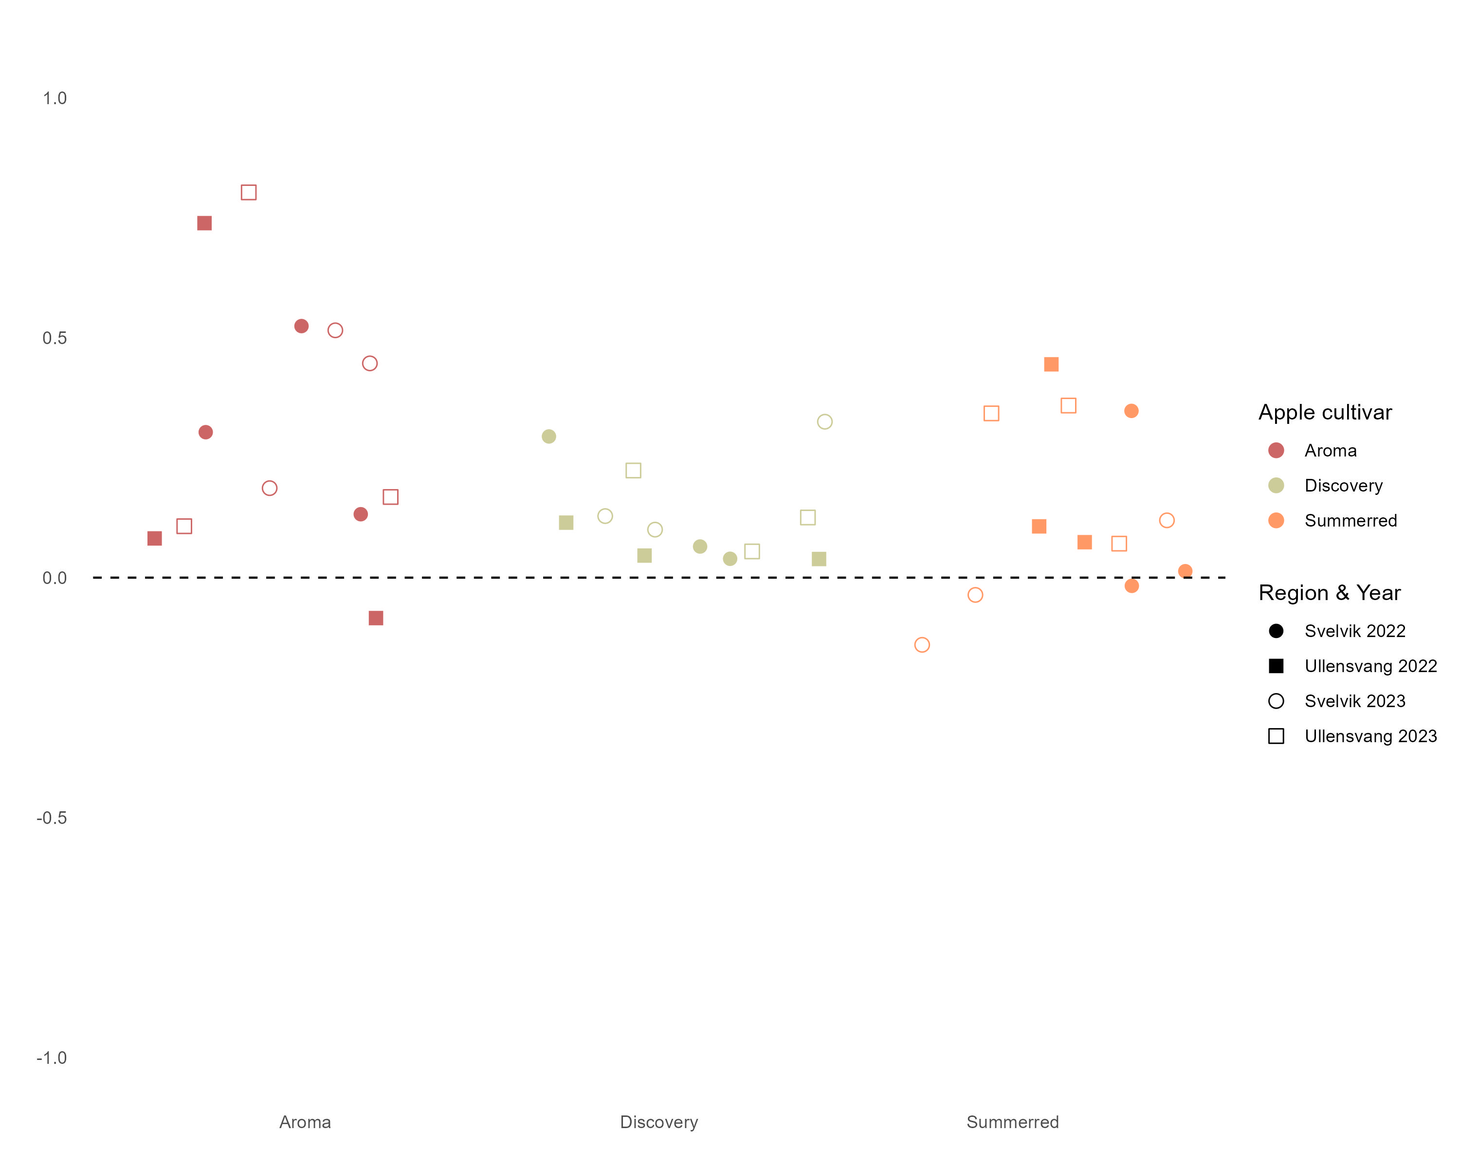
Deficit
Surplus

Slide 4
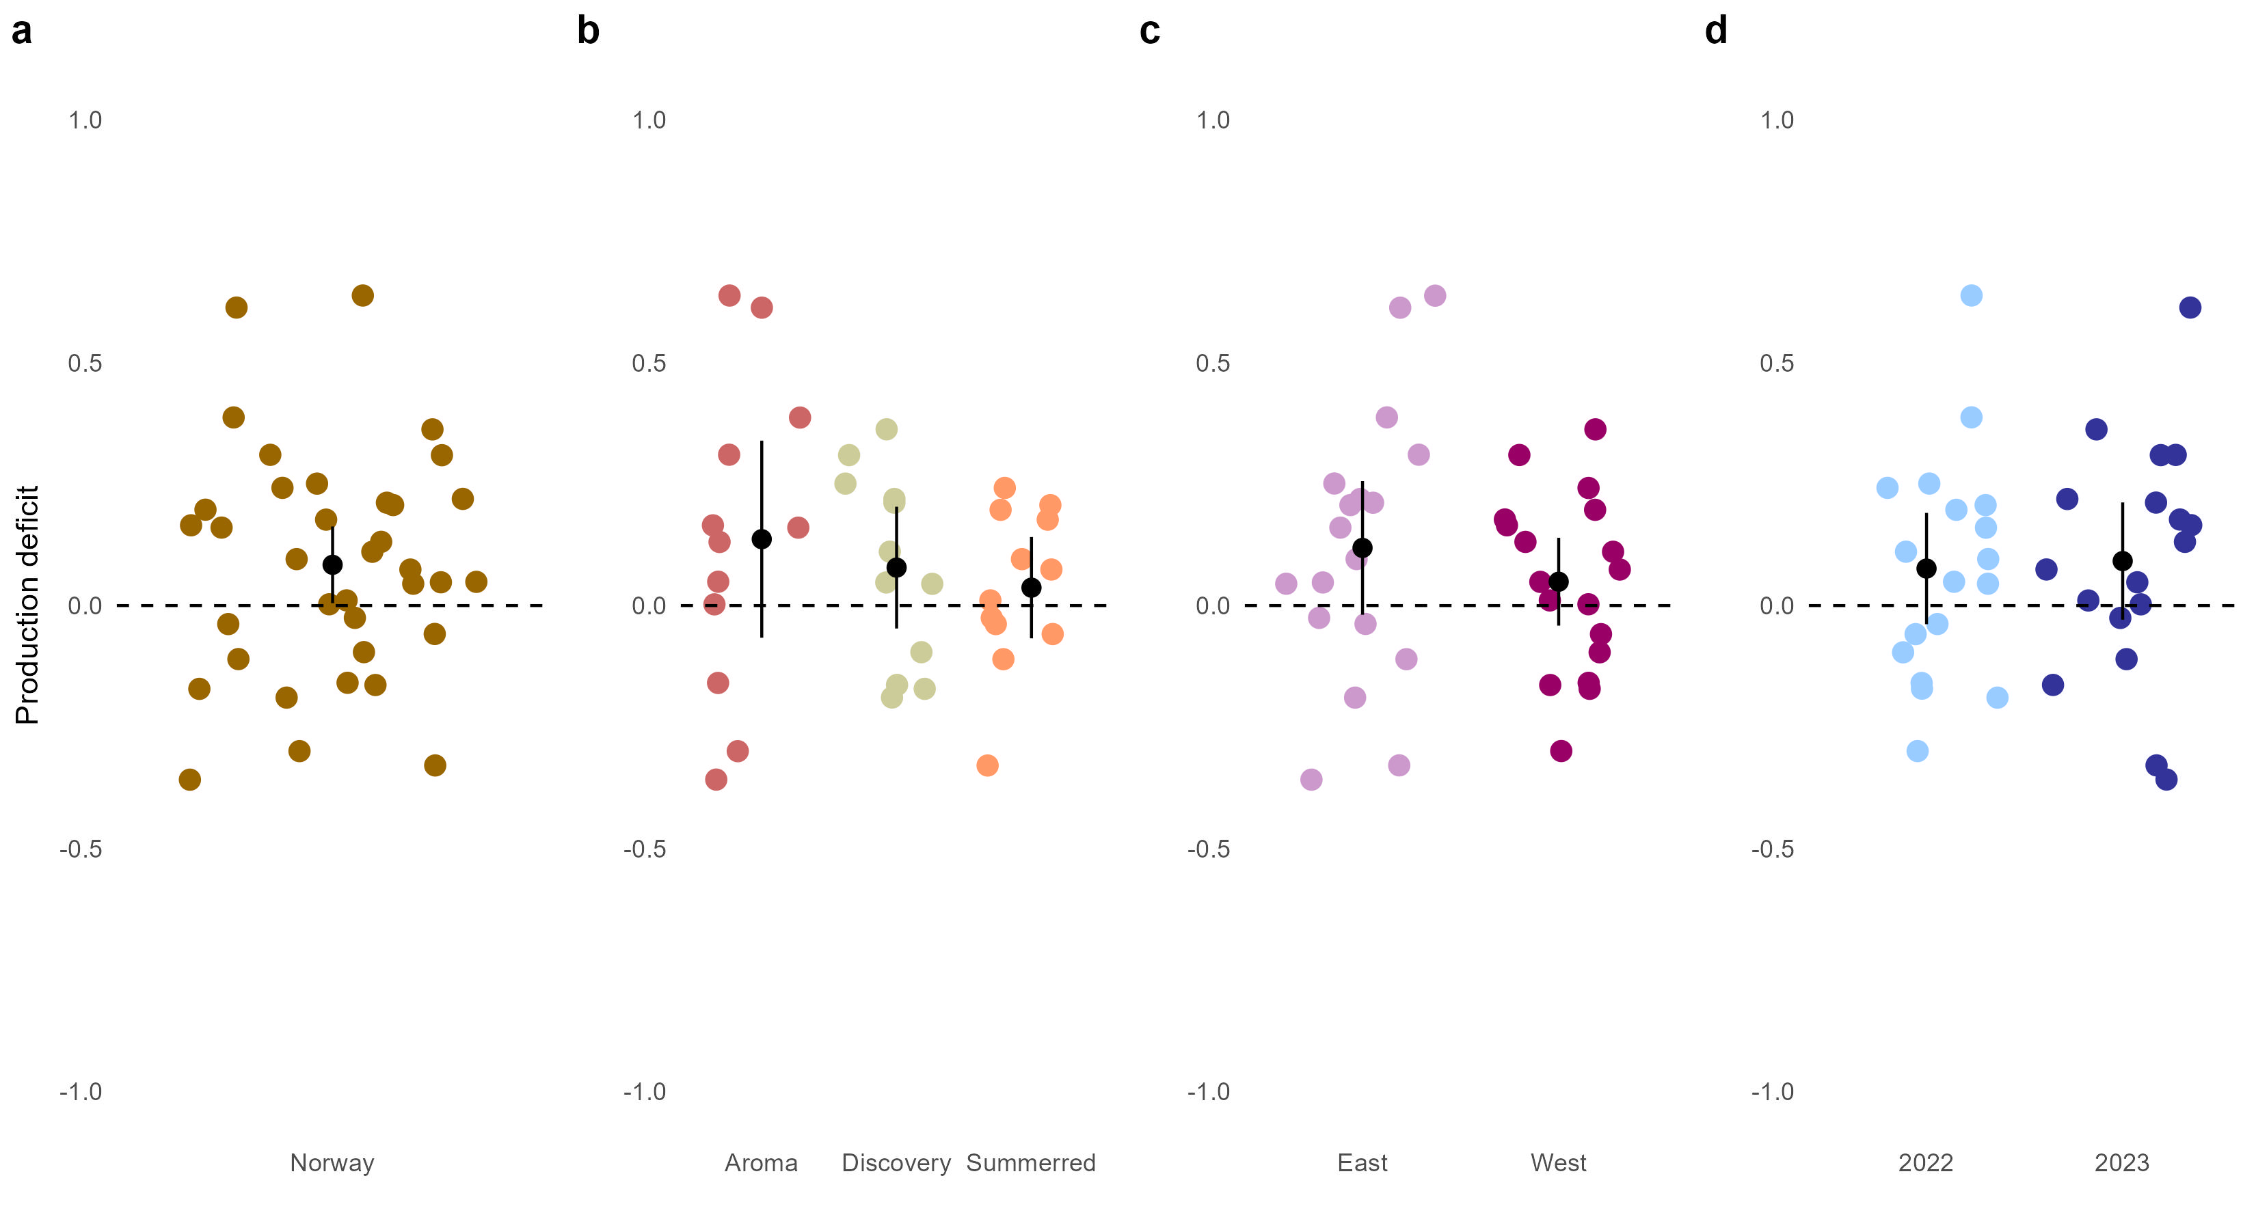
Production deficit
Surplus production

Slide 5
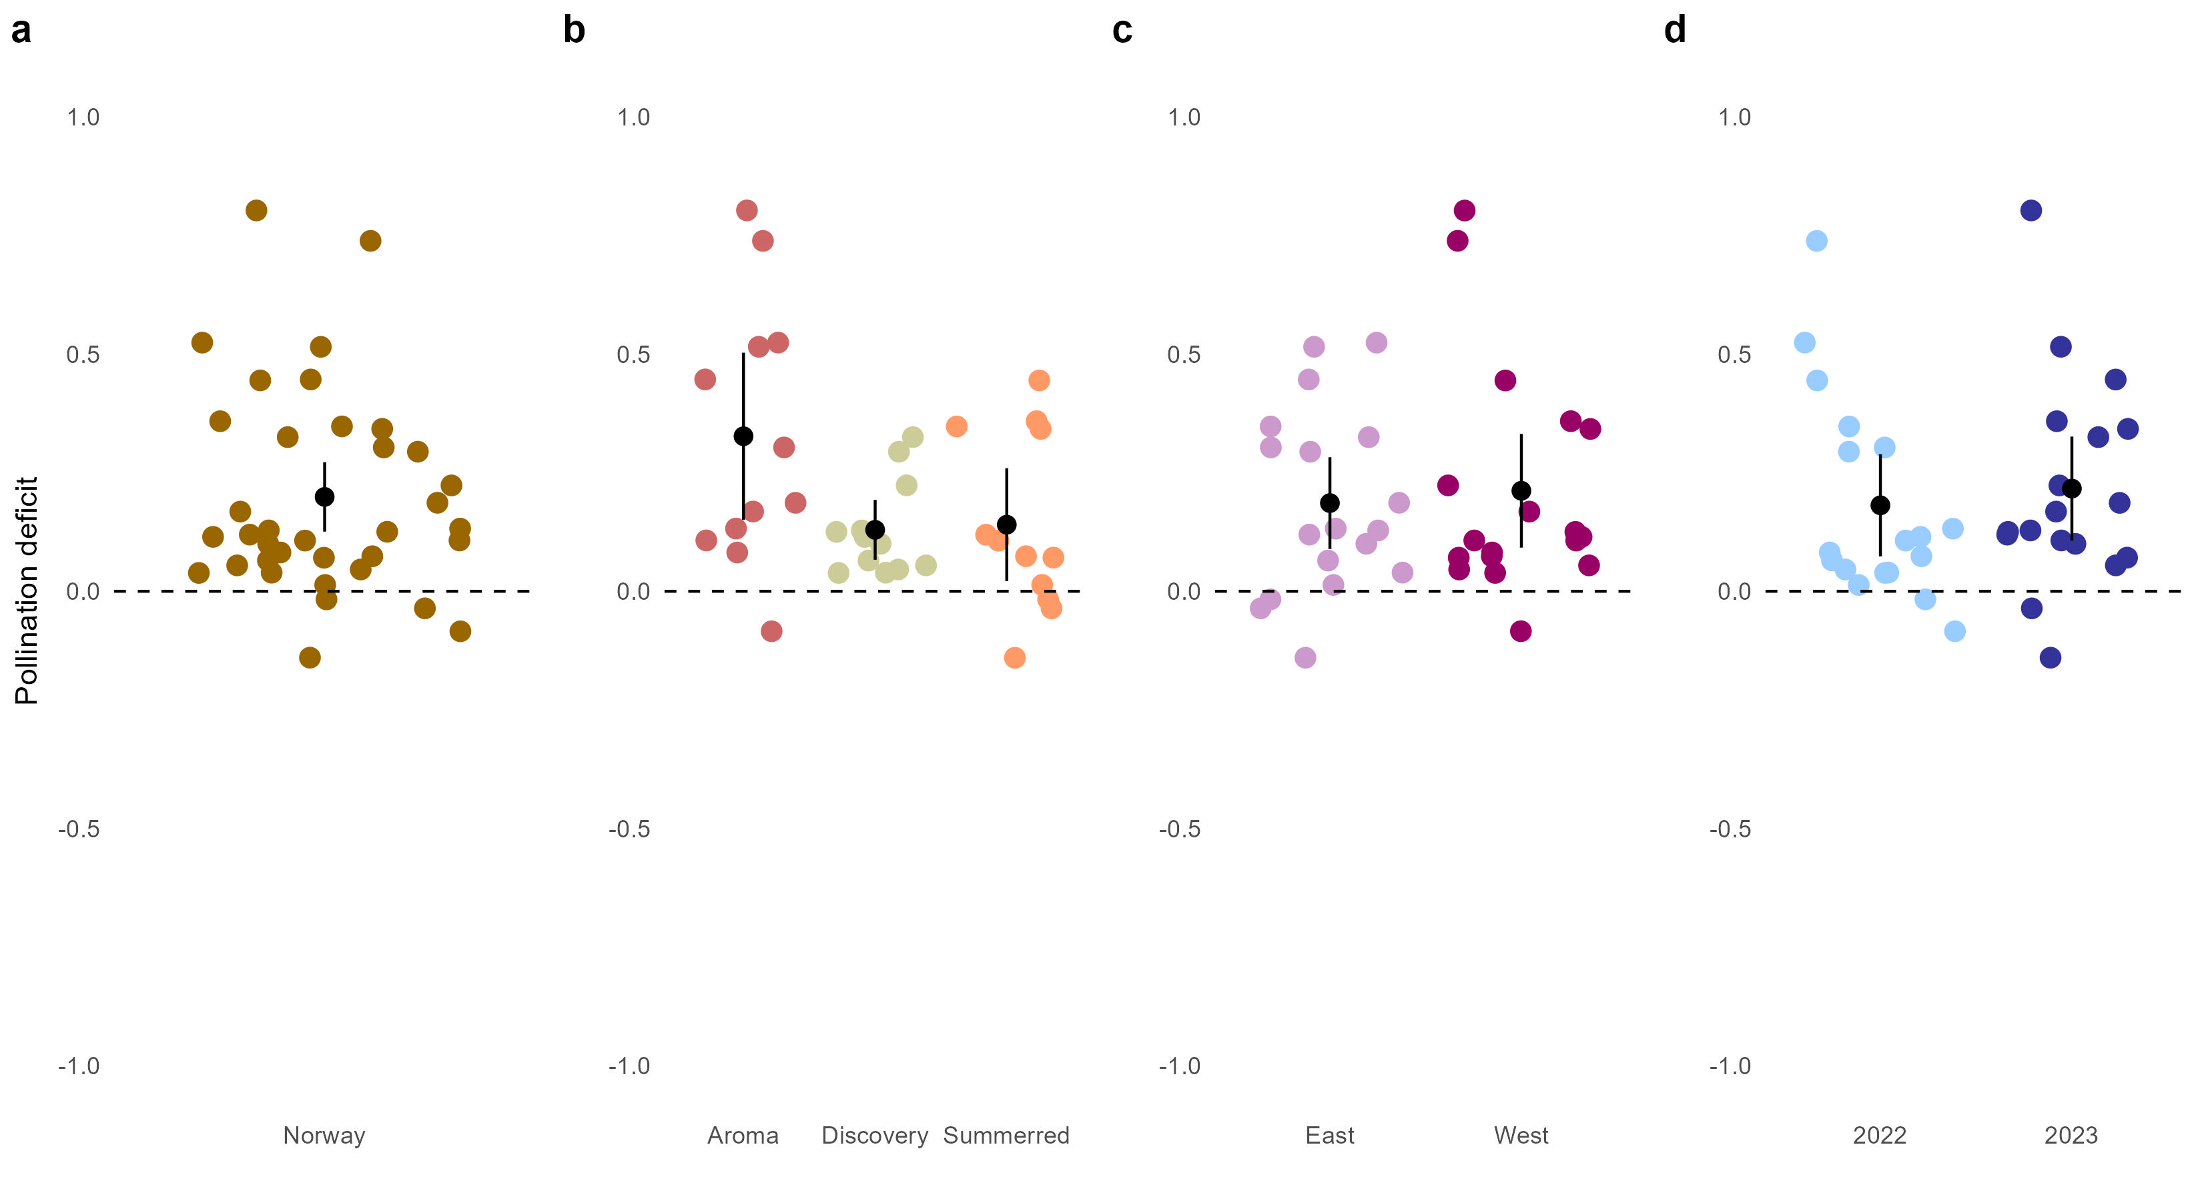
Pollination deficit
Surplus pollination

Slide 6
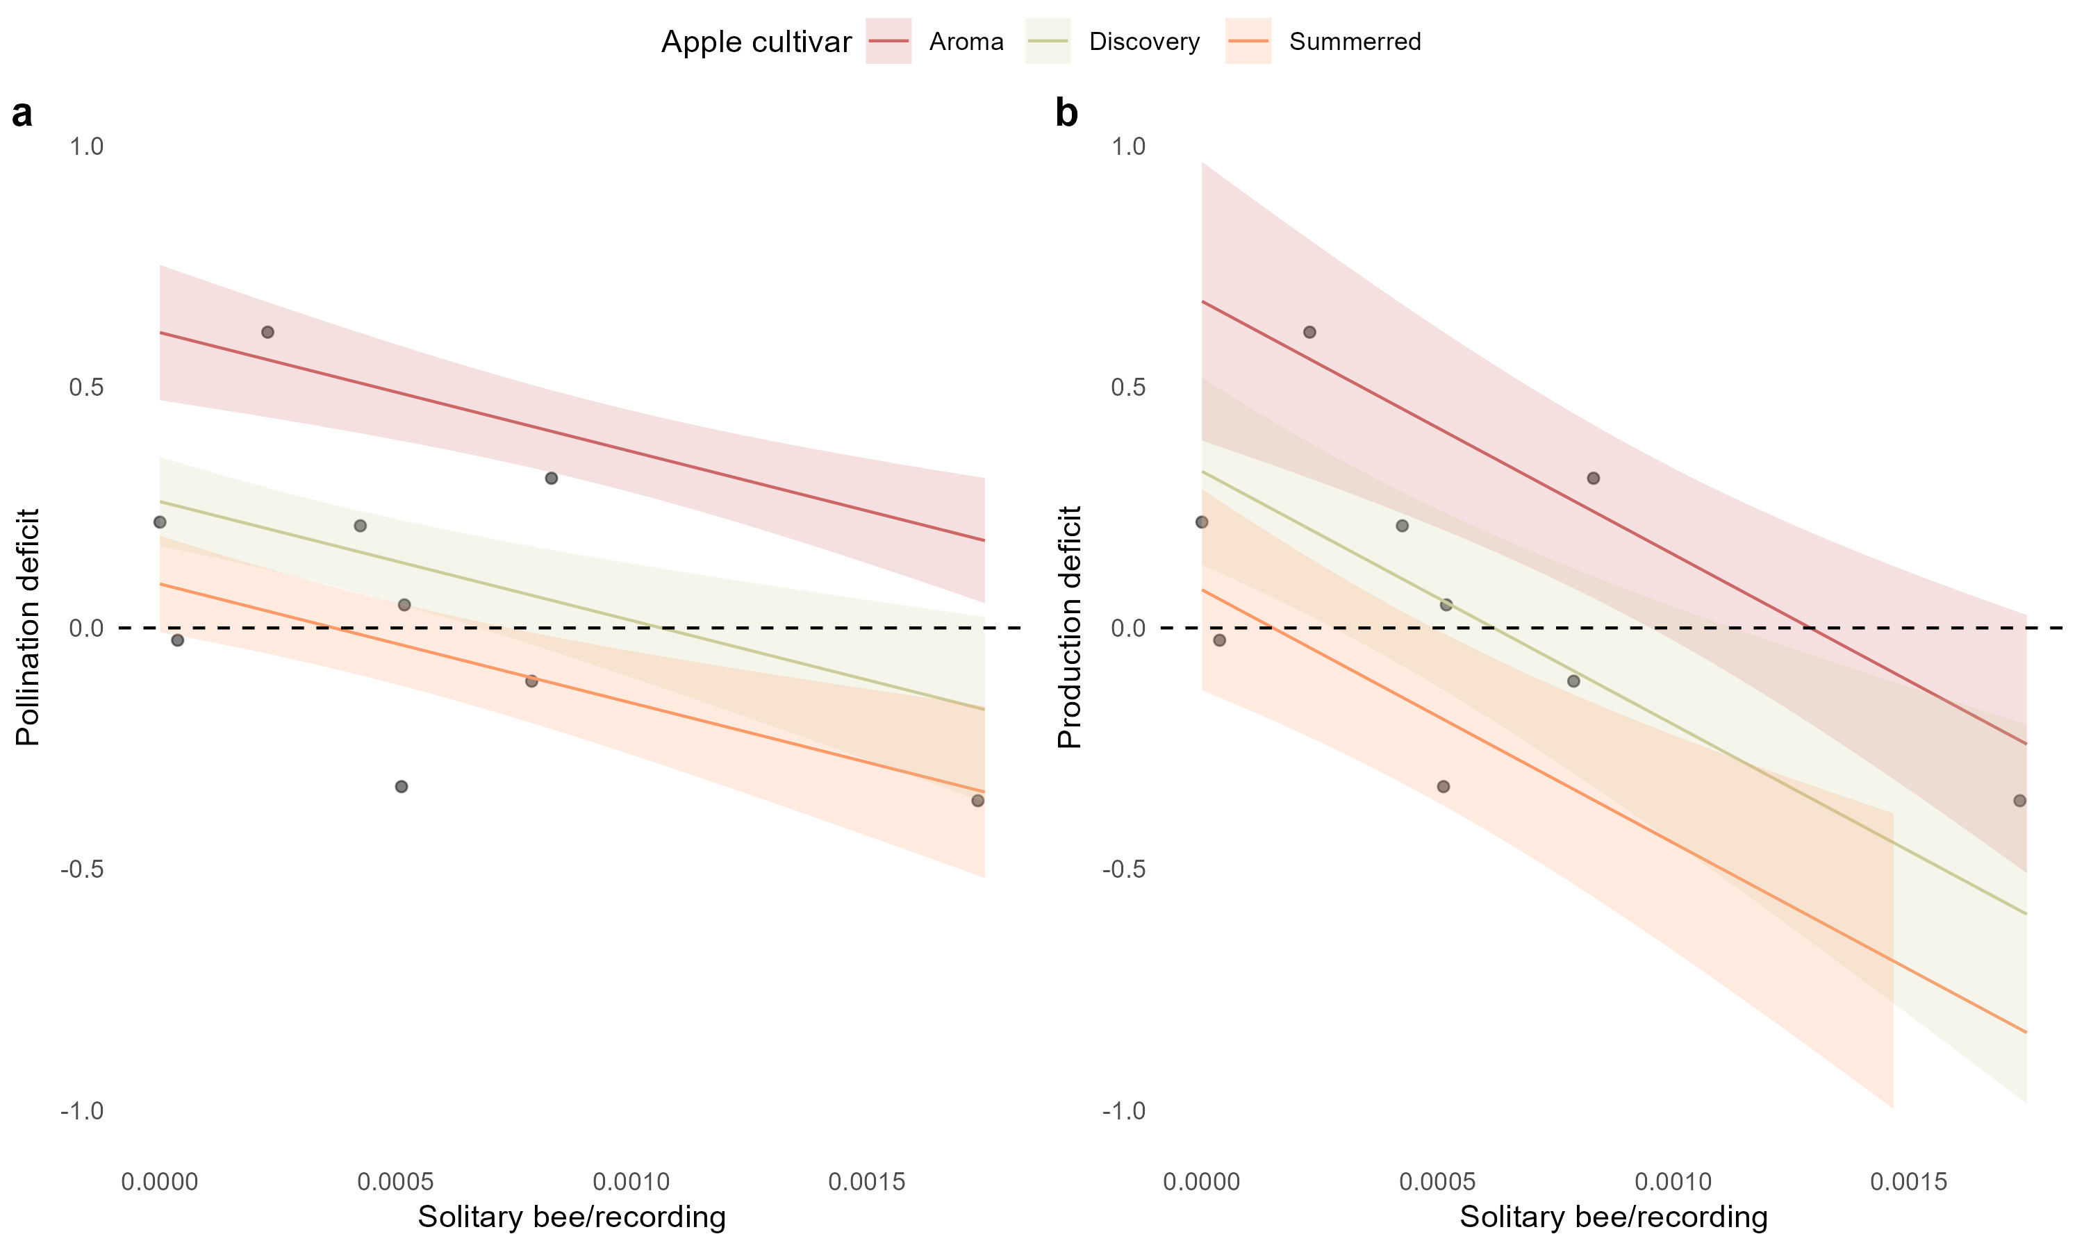
Pollination deficit
Production deficit
Surplus pollination
Surplus production

Slide 7
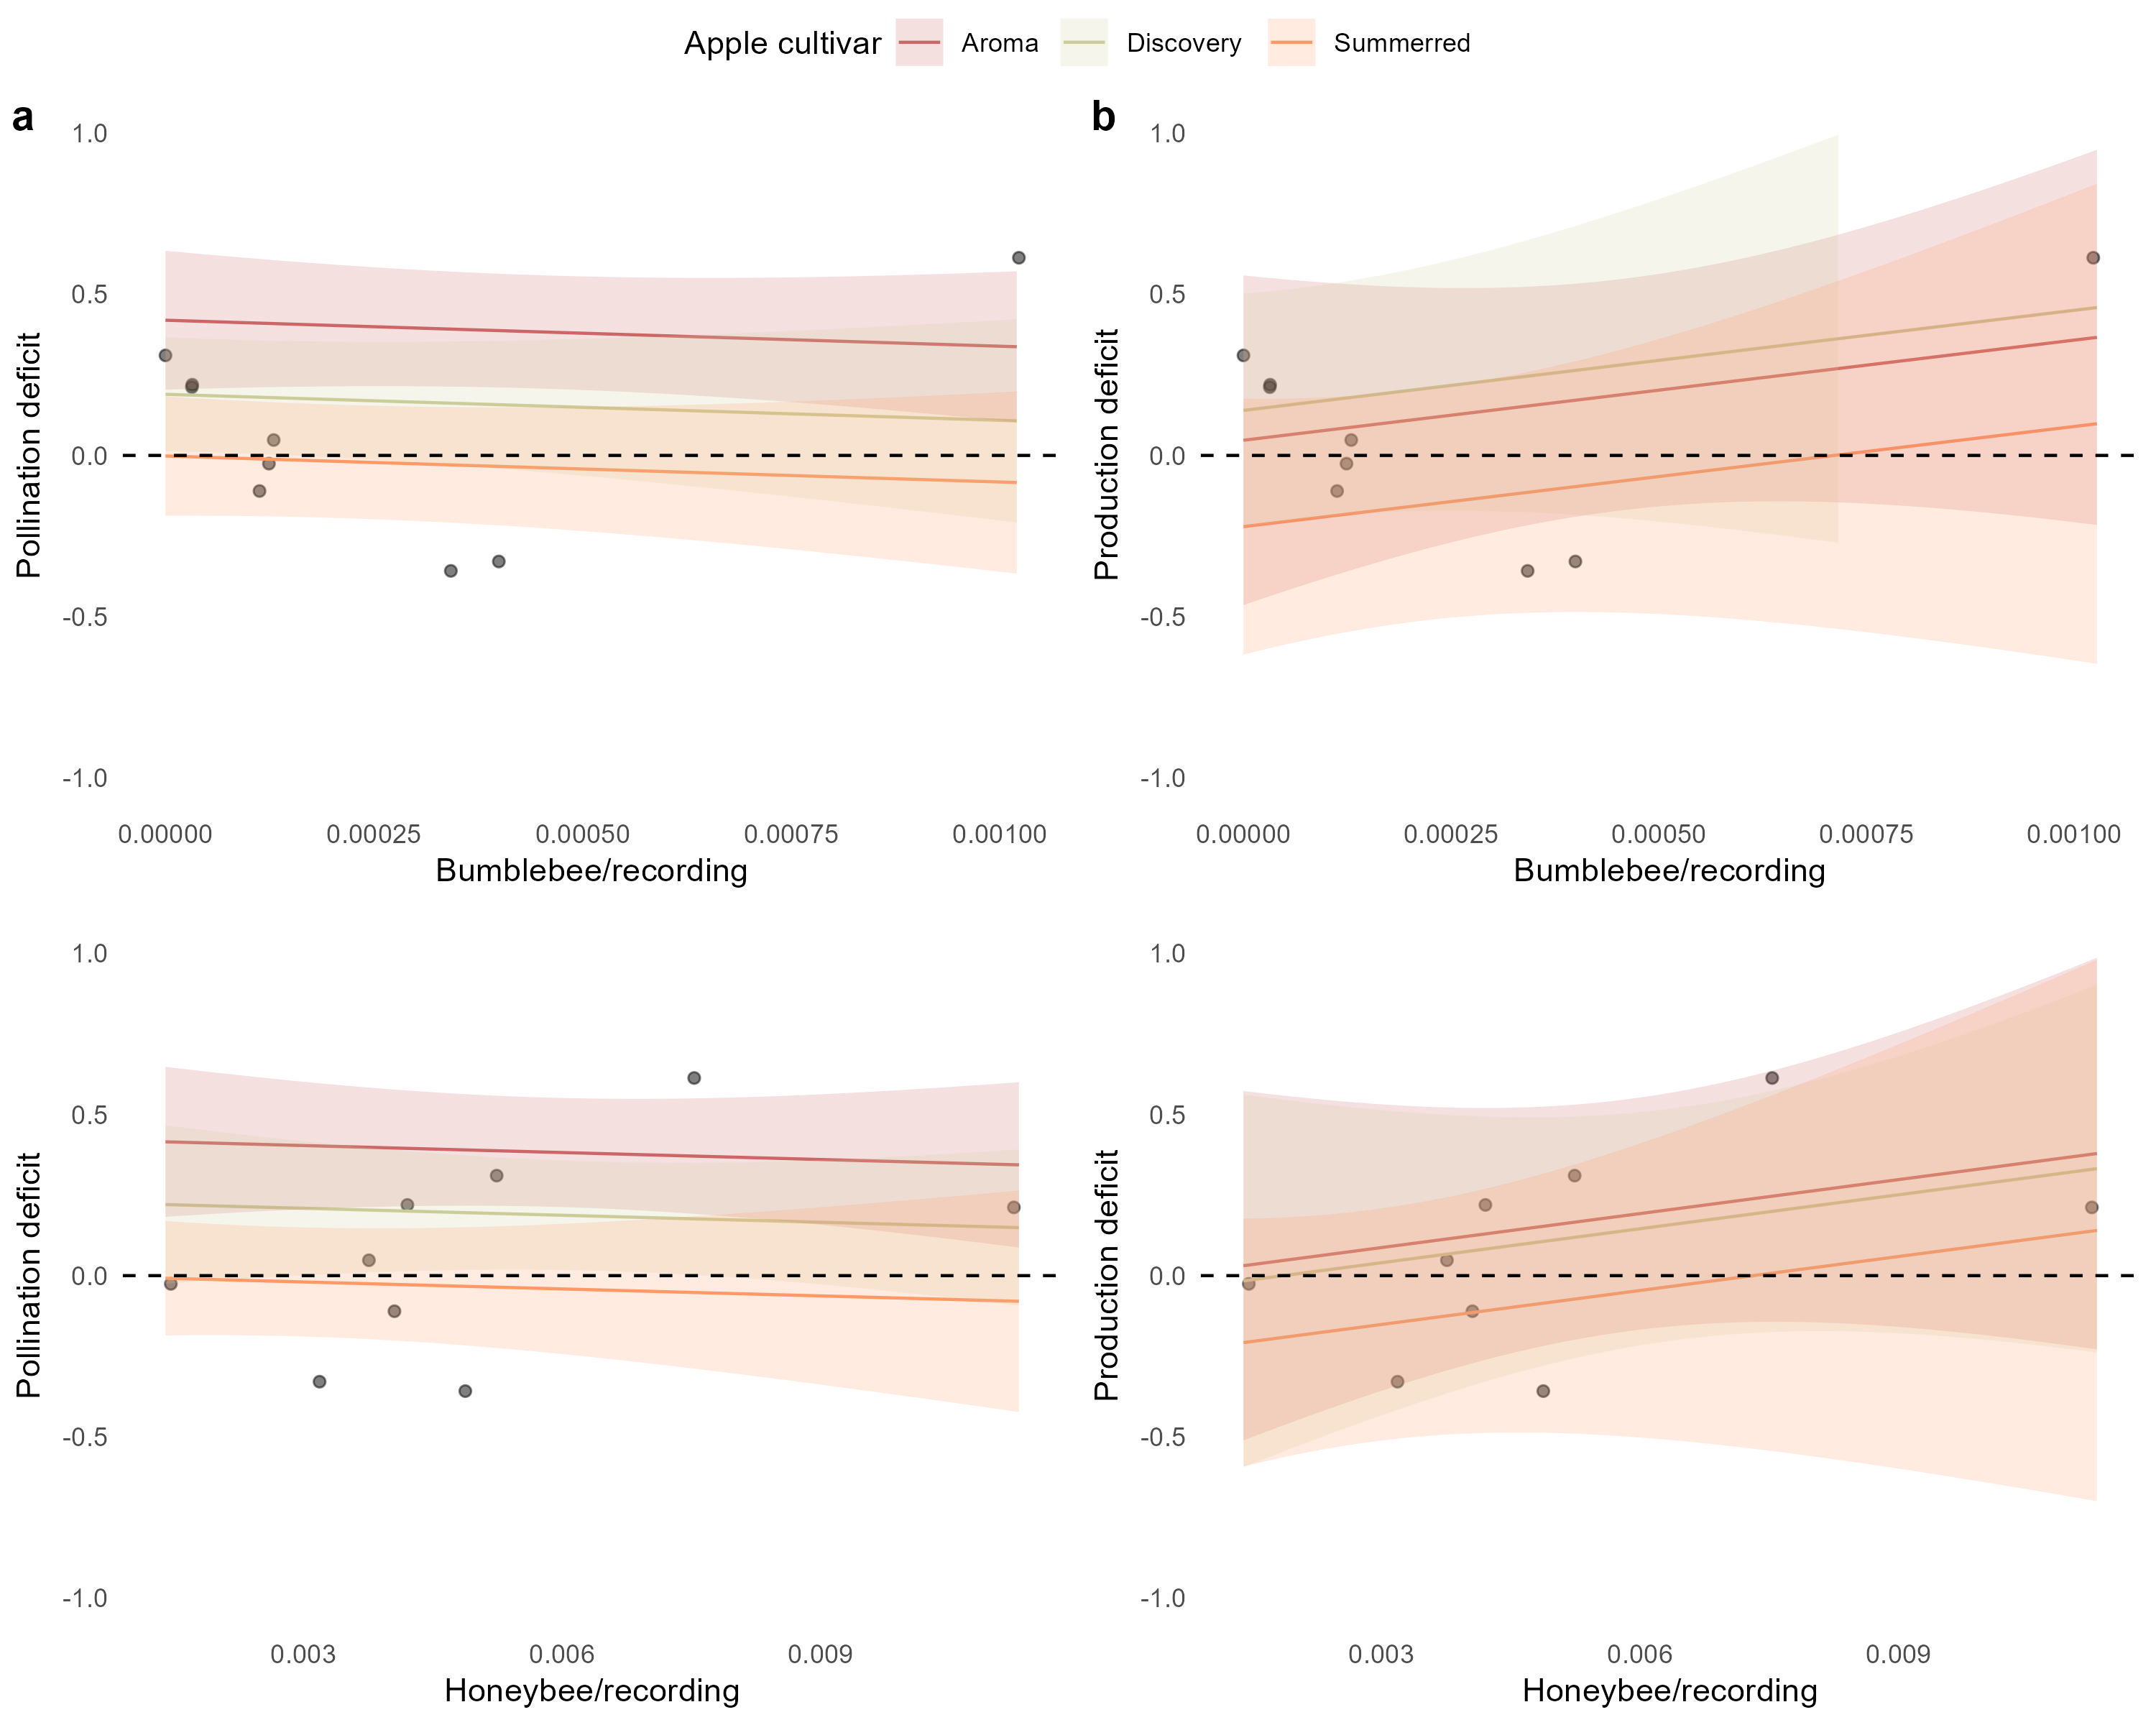
Pollination deficit
Production deficit
Surplus pollination
Surplus production
Pollination deficit
Poduction deficit
Surplus pollination
Surplus production

Slide 8
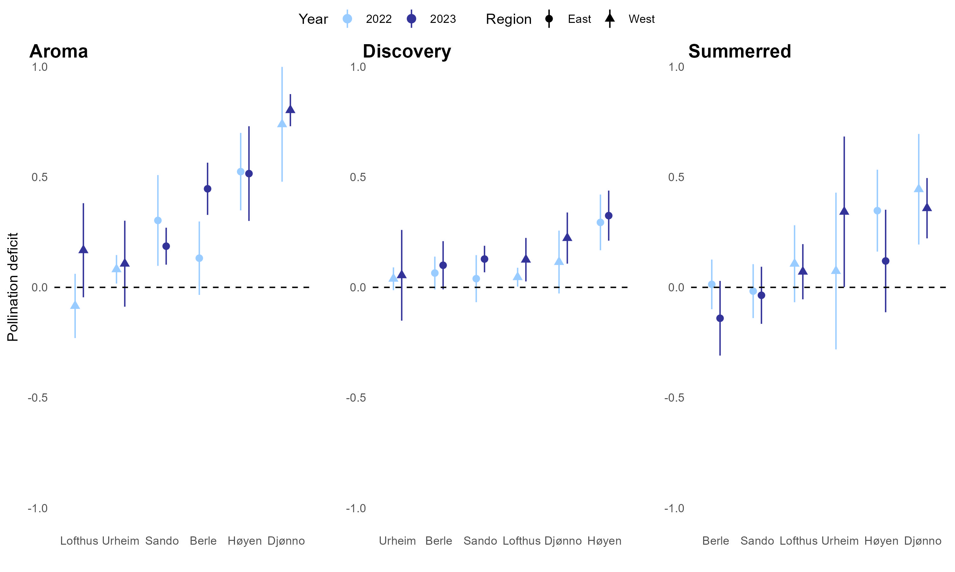
Pollination deficit
Surplus pollination

Slide 9
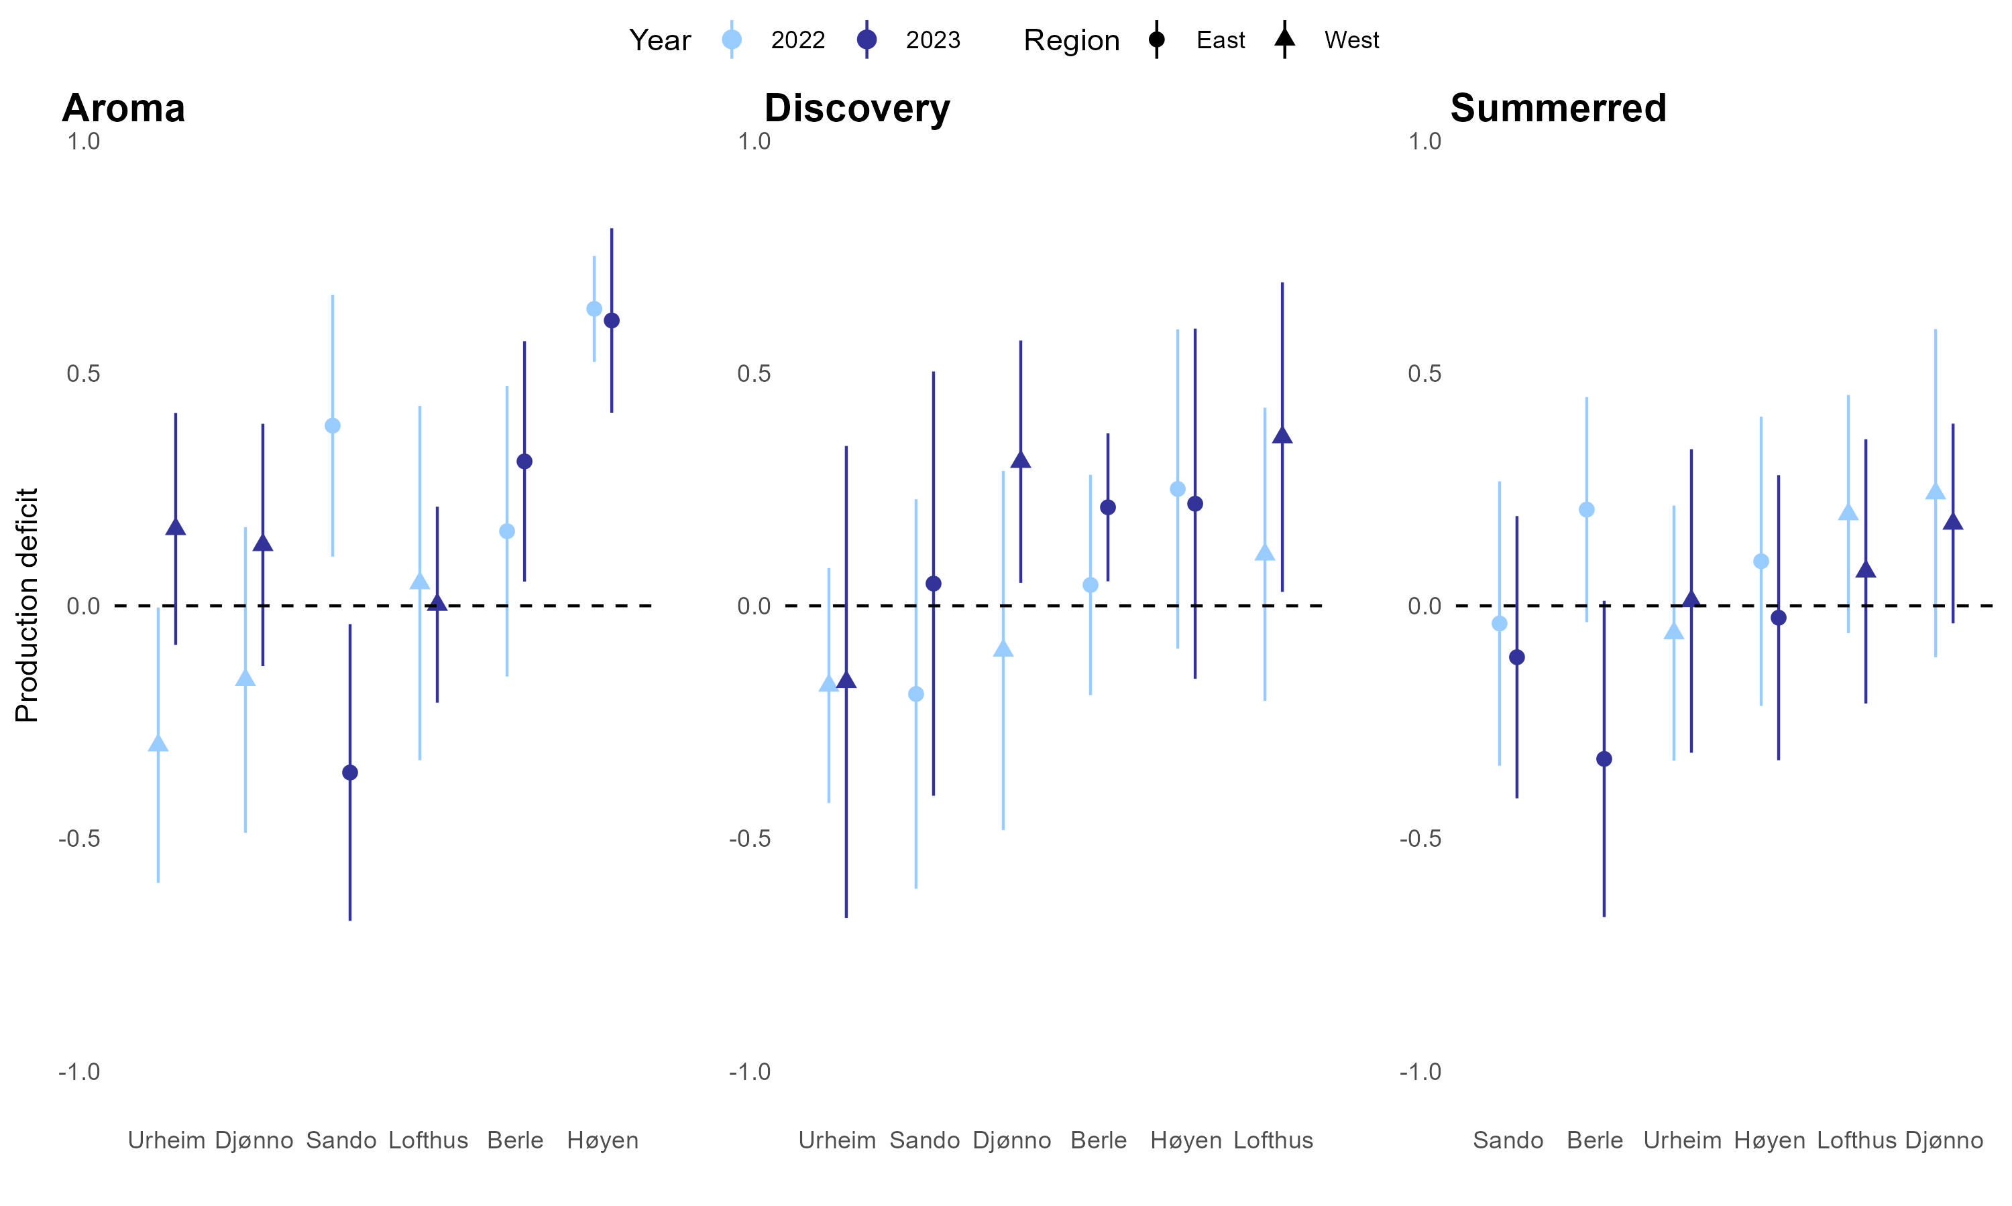
Production deficit
Surplus production

